Slide 1
Machine Learning Basics
Subhash Jadhav
Overfitting, Underfitting, Bias-Variance Tradeoff, and Loss Function

Slide 2
Underfitting Vs Overfitting
Subhash Jadhav
Underfitting occurs when a model is too simple to capture the underlying trends in the training data
Causes:
  Choosing a wrong model: Model not suitable for the problem.
  Model simplicity: Too few parameters to capture complexity.
  High bias, low variance: Model biased towards systematic errors.
Signs:
  Very low training data accuracy.
Prevention:
  Choose the correct model for the problem.
  Increase model complexity by adding more parameters.
  Allow the model to learn more features for better performance.
  Emphasize bias-variance tradeoff for a balanced model.
Overfitting occurs when a model learns the training data too well, capturing noise and outliers instead of the underlying pattern
Causes:
  Less data: Small datasets may lead to memorization.
  Increased complexity: Complex models may fit the training data too closely.
  More layers in neural networks: Deep architectures may capture noise.
Signs:
  High training data accuracy, low test data accuracy.
Prevention:
  Use more data for better generalization.
  Reduce model complexity, especially in neural networks.
  Early stopping to prevent overfitting.
  Utilize bias-variance tradeoff for optimal model complexity.
  Use dropouts in deep learning to prevent overfitting.

Slide 3
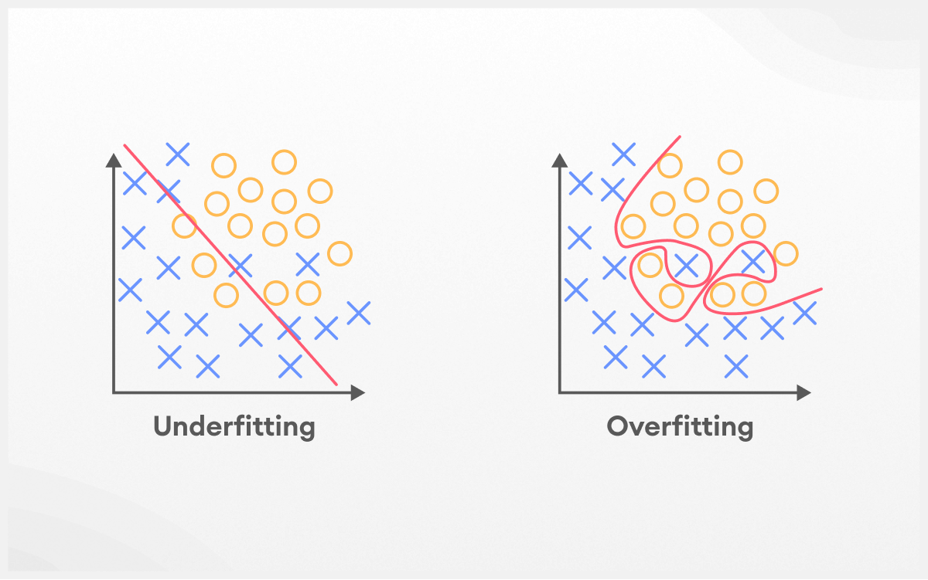
Underfitting Vs Overfitting
Subhash Jadhav

Slide 4
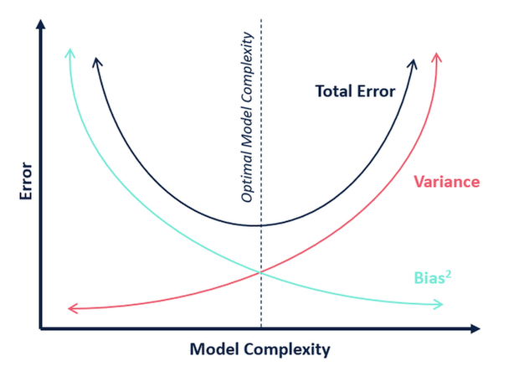
Bias-Variance Tradeoff in Machine Learning
Subhash Jadhav
Bias: Difference between average prediction and true value
Variance: Amount the estimate changes with different training data
Underfitting: High bias, low variance
Overfitting: Low bias, high variance

Slide 5
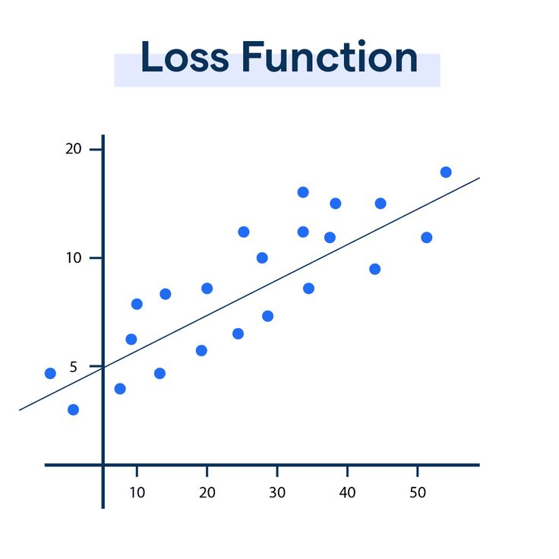
Loss function
Subhash Jadhav
A loss function measures how far the model's predictions are from the true values.
It helps evaluate model performance and compare different models
Application:
  Choose models with lower loss for better predictive performance.
  Utilize loss functions to determine model performance.

Slide 6
summary
Subhash Jadhav
Overfitting captures noise, underfitting fails to capture patterns
Balancing overfitting and underfitting is crucial for model generalization

